Slide 1



Data Structure
&
Algorithm
Class IX
lab 11

Slide 2


Merge Sort Algorithm
Merge sort is a sorting technique based on divide and conquer technique.

Slide 3
Algorithm
Step 1 − if it is only one element in the list it is already sorted, return.
Step 2 − divide the list recursively into two halves until it can no more be divided.
Step 3 − merge the smaller lists into new list in sorted order.

Slide 4
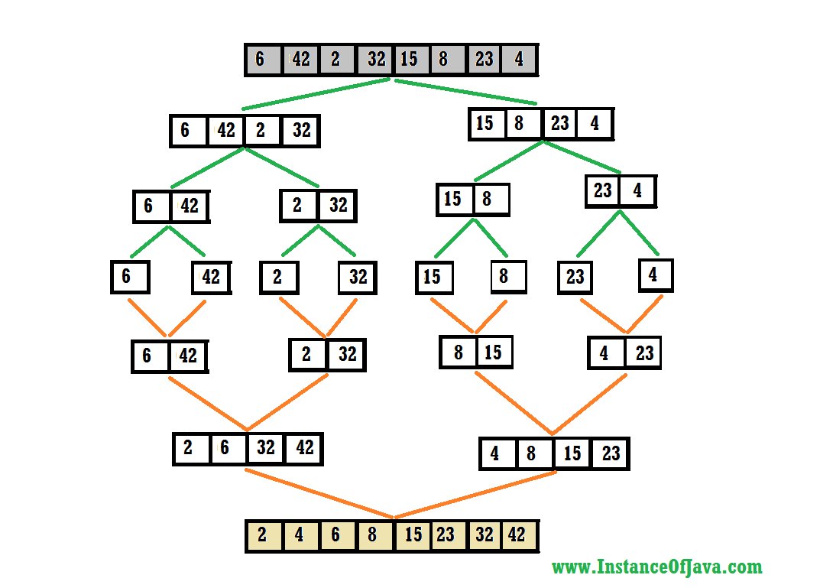
Example 1

Slide 5
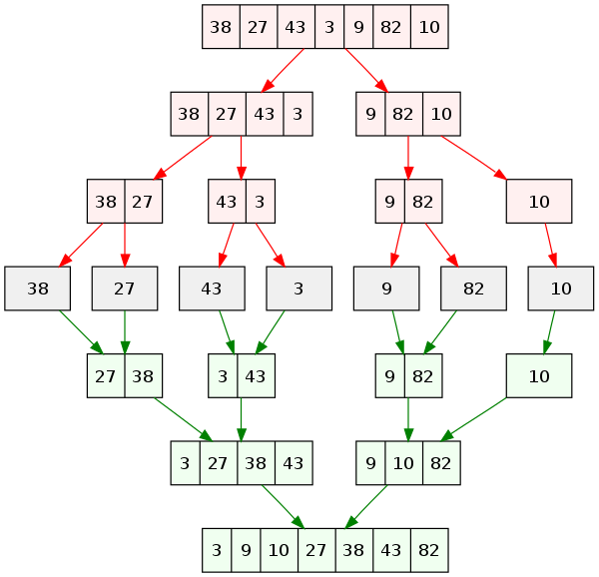
Example 2

Slide 6
Example 2

Slide 7


